Slide 1
React.js
Team Seven

Slide 2
Learning Objectives
Have a basic understanding of the background of React and the niche it fills
Understand the importance of React
Understand how React is different from other libraries
Have a grasp of the basic features of React
How React can interact with other libraries/frameworks
Notes:
byeeeeeee

Slide 3
Background
Created by Facebook engineer Jordan Walke, first used in 2011
Still maintained by Facebook
First public release: May 2013
Currently released under the MIT licence (very few restrictions on use)

Slide 4
Importance of React.js
Open Source
Component-Style architecture
Customizable components and component reusability
Up-to-date
Easier to learn

Slide 5
Basic Features

Slide 6

Basic Features - Syntax
JSX is a syntax extension to JavaScript. It is used with React to describe what the UI should look like.
This is an example of an element.
Credits to reactjs.org

Slide 7
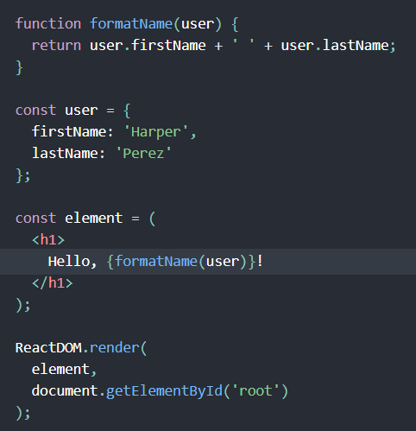
Basic Features - Syntax
You can use any valid JavaScript expression in JSX by wrapping it in curly braces.
Function that returns a string
Object with 2 properties
Using curly braces, the result of the function call is embedded in the JSX
Credits to reactjs.org

Slide 8
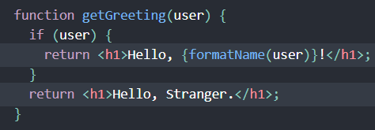
Basic Features - Syntax
After compilation, JSX expressions become regular JavaScript function calls and evaluate to JavaScript objects
So you can do things like assign JSX to variables, return JSX, and pass JSX as arguments
Credits to reactjs.org

Slide 9
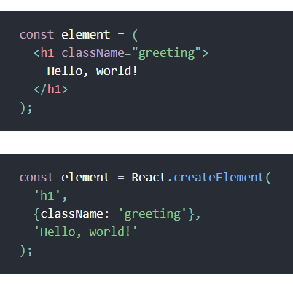
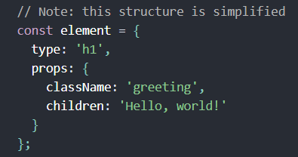
Basic Features - Syntax
Babel compiles JSX down to React.createElement() calls.
These React Elements can be thought of as objects like this:
These two snippets of code do the same thing
Credits to reactjs.org

Slide 10

Basic Features - Rendering Elements
Elements are the smallest units used to build things in React apps
According to reactjs.org: “Unlike browser DOM elements, React elements are plain objects, and are cheap to create. React DOM takes care of updating the DOM to match the React elements.”
(Recall that DOM = Document Object Model)
Credits to reactjs.org

Slide 11


Basic Features - Rendering Elements
“root” DOM node - everything inside it will be managed by React DOM.
← assume this is already somewhere in your HTML
To render a React element into a root DOM node, pass both to ReactDOM.render():
Result:
Credits to reactjs.org

Slide 12
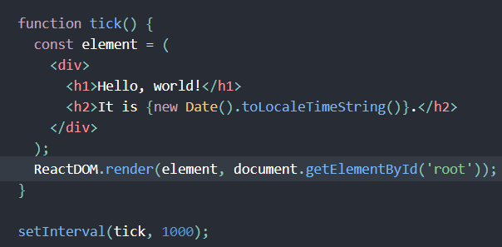
Basic Features - Rendering Elements
Immutable
Once you create a React element, you can’t change its children or attributes.
One way to alter the HTML is to call ReactDOM.render() again.
“React DOM compares the element and its children to the previous one, and only applies the DOM updates necessary to bring the DOM to the desired state.”
Credits to reactjs.org

Slide 13

Basic Features - Components and Props
Components - not to be confused with elements!
Conceptually analogous to JavaScript functions
Inputs to components are called “props”
Return React elements
“function component” - accepts a single “props” object argument and returns a React element and is literally a JavaScript function
Credits to reactjs.org

Slide 14
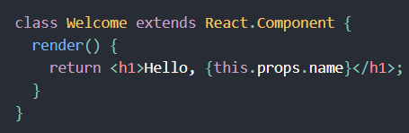
Basic Features - Components and Props
Another way to define a component is to use a class.
This is equivalent to the previous slide that used function component form
Credits to reactjs.org

Slide 15


Basic Features - Components and Props
React elements can represent DOM tags or user-defined components
When React sees an element representing a user-defined component, it passes JSX attributes and children to this component as a single object (“props”). The user defined component will then return a React element.
Credits to reactjs.org

Slide 16
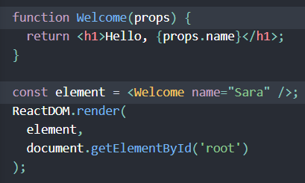
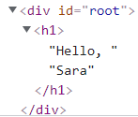
Basic Features - Components and Props
We call ReactDOM.render() with the <Welcome name="Sara" /> element.
React calls the Welcome component with {name: 'Sara'} as the props.
Our Welcome component returns a <h1>Hello, Sara</h1> element as the result.
React DOM efficiently updates the DOM to match <h1>Hello, Sara</h1>.
Credits to reactjs.org
Notes:
Example using an element that represents a user-defined component instead of a DOM tag

Slide 17
Basic Features - Components and Props
Using Components
Components can refer to other components in their output. This allows for easy reuse of various components such as buttons, forms, etc and allows for separation of functionality
Can also create one huge component with a bunch of nested elements, but that can be hard to manage
Strict Rule to Follow:
Props are read-only! Don’t change!
Credits to reactjs.org
Notes:
Example using an element that represents a user-defined component instead of a DOM tag

Slide 18
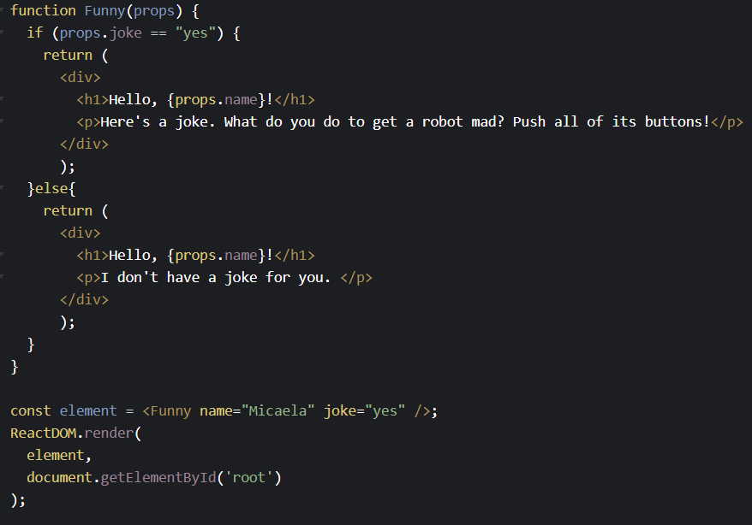
Your turn
What does this display?

Slide 19
Basic Features - State and Lifecycle
State is specified by use of a class (specific to ES6 and later)
State is a property of an object (this keyword), distinct from an object’s props (properties)
Lifecycle: the lifespan of an object, e.g. when it is released back into memory
React uses special lifecycle methods, componentDidMount() and componentWillUnmount() to handle lifecycle events
Warning: the state of an element is encapsulated, meaning that nothing has access to a component’s state except that component itself
Notes:
Nathan
this.state instead of this.props, since state has to be maintained by the element itself
mount and unmount control allocation and freeing of state; unmounting when done is like freeing in C; it lets things run smoother

Slide 20
Basic Features - Handling Events
Event handling is similar to using Javascript on DOM elements like normal, except for some syntax differences because of JSX
JSX is a syntax extension of Javascript that converts HTML tag sinto React elements
JSX is not required for React, but it is useful
JSX combines the logic and markup of a page into a single representation
Notes:
Nathan

Slide 21
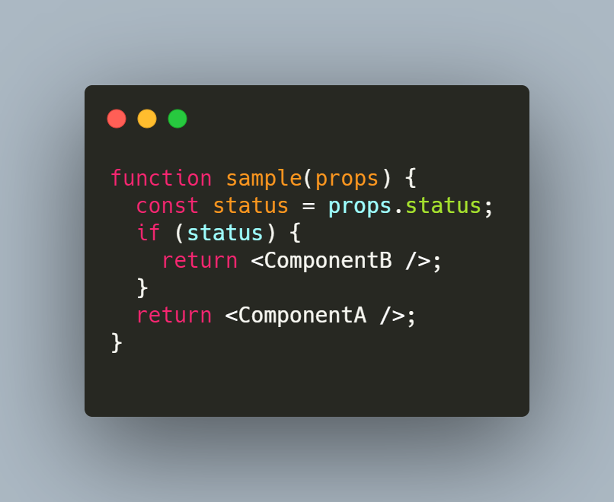
Basic Features - Conditional Rendering
Controlling a component’s rendering is as simple as checking a boolean value and choosing what to render
Tricks like the ternary operator and short-circuit evaluation can make code more elegant
Notes:
Nathan

Slide 22
Basic Features - Lifting State Up
First state added for data is typically in the component that needs it for rendering.
If other components also need that data, you can lift it up to their closest common ancestor.
If something can be derived from either props or state, it probably shouldn’t be in the state.
E.g. Rather than storing celsiusValue and fahrenheitValue, just store the last edited temperature and its scale (C or F).
Credits to reactjs.org

Slide 23
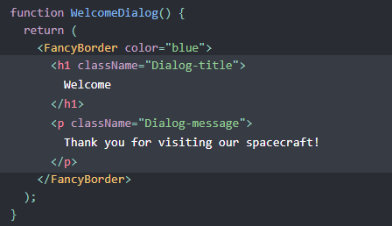
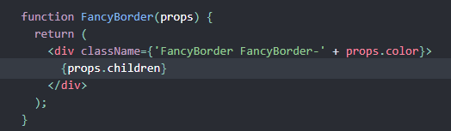
Basic Features - Composition vs Inheritance
It is recommended to use composition rather than inheritance to reuse code between components.
Facebook uses React in thousands of components and hasn’t found any cases where they would recommend creating component inheritance hierarchies.
The special “children” prop is used to pass children elements into their output.
Containment & Specialization
Credits to reactjs.org

Slide 24
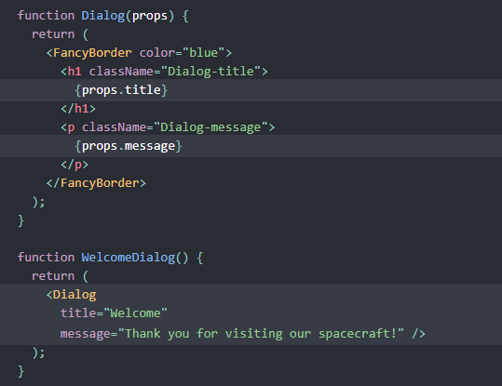
Basic Features - Composition vs Inheritance
Specialization Example:
A more “specific” component renders a more “generic” one and configures it with props.
Credits to reactjs.org

Slide 25
Interactions + Applications of React

Slide 26
Interactions + Applications - Basic Information
For building modern applications - handles the view layer
Used by developers for many types of applications
User Interfaces for web, desktop, and hybrid applications
As a flexible library itself, it can be used in combination of other JavaScript libraries or frameworks
Make using React or creating UIs easier/more efficient
Uses its many internal component libraries

Slide 27
Interactions - Component Libraries
Whole ecosystem of libraries surrounding React ! (simply import the library package)
Ready to use components
Material UI - React development library
One of the most prevalent UI libraries
prebuilt React components to follow material design standard
can plug into any application without having to use app developers
$ npm install @mui/material - terminal command
Faster, simpler, highly customizable
React - Bootstrap
Popular in HTML, JavaScript and CSS libraries
Includes UI creation elements for web and mobile applications
Redux
framework for managing state changes in react applications
really common - makes handling data easier, stores states in a way that is easy for react to use (undo, redo)
Ant Design, React-Router

Slide 28
Interactions - Renderers
Renderers manage how a React tree translates into its underlying platform calls
Transforms into respective platforms’ elements and views
Web Applications
react-DOM - library to build UIs in web browsers
Electron - can run apps that are from browser and make it look like a real native app
Mobile Applications
React Native - framework that supports Native platforms for building Native apps in React
Compiles into actual Native code used for real applications, not just on a web browser
3-D - React Unity
Renders react components to Unity
Other Categories
Television, hardware, email

Slide 29
How React is different from other frameworks?

Slide 30
How React is different from Angular and Vue?
React
Uses JSX. Allows programmers to write HTML inside JavaScript files.
Uses Virtual DOM.
One-way data binding.
Angular
A full-fledged model-view-controller (MVC) framework.
Uses regular DOM.
Two-way data binding.
Model state: reflects any modifications made to the UI elements.
UI state: reflects any modifications in the model state.
Vue
Contains special file type similar to JSX.
Uses Virtual DOM.
Reactive two-way binding. (Supports both one-way binding and two-way binding)

Slide 31
In the Aspects of State Management, Routing, Client-Server Communication
 | State Management | Routing | Client-Server Communication
React | React contains many libraries for state Management. Inbuilt solution: React Context | Doesn’t have inbuilt solution for Routing. It contains third-party packages: React Router and Wouter. | Axios and Fetch are used. Both are the libraries to consume and display data from an API.
Angular | Inbuilt solution: NGXS and NGRX | Have inbuilt Router to handle normal routing, nested routing, redirect, parameter passing, etc. | HTTP Client module is used to allow the application to make standard API calls.
Vue | Vue has its own state management library called Vuex. Vuex enables the application to store and communicate data without trading off its performance. | Similar to Angular. | Similar to React.

Slide 32
Works Cited
Jey, V. (2021, October 14). React vs. other frameworks: A comparison in 3 aspects. Medium. Retrieved November 16, 2021, from https://javascript.plainenglish.io/react-vs-other-frameworks-a-comparison-in-3-aspects-756ab84b8d95.
Kaya, A. A. (2021, July 11). A 2021 comparison of the best frontend JavaScript frameworks. Medium. Retrieved November 16, 2021, from https://javascript.plainenglish.io/best-frontend-javascript-framework-96ecef9791fa.
Lobera, A. (2019, January 30). React is all about composition. Medium. Retrieved November 18, 2021, from
https://medium.com/leanjs/react-is-all-about-composition-f9f49dec183c.
React (Javascript library). Wikipedia. Retrieved November 16, 2021, from https://en.wikipedia.org/wiki/React_(JavaScript_library)
Integrating with other libraries. React. (n.d.). Retrieved November 18, 2021, from https://reactjs.org/docs/integrating-with-other-libraries.html
16 best react component libraries for 2021-2022: Technostacks. Technostacks Infotech. (2021, August 26). Retrieved November 18, 2021, from https://technostacks.com/blog/react-component-libraries
part 1/3 - beginners guide to custom react renderers ... (n.d.). Retrieved November 18, 2021, from https://blog.atulr.com/react-custom-renderer-1/

